Slide 1
Fast HOSVD For Brain Imaging Data
Suna Guo
CSC 352 NLA

Slide 2
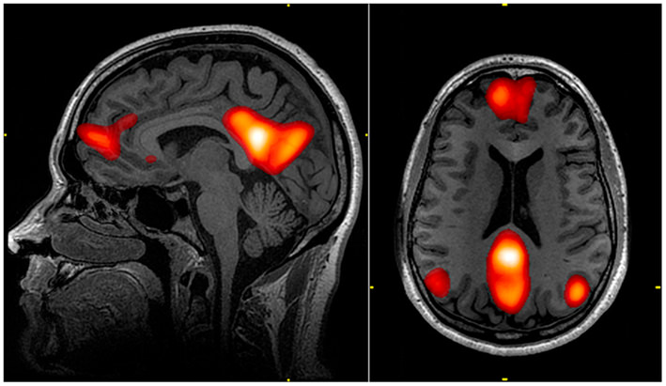
Neuroimaging Studies
Neuron activities:
Represent thoughts and behavior
Study neuron activity pattern
Understand brain function
Model activity (neural networks)
Predict health condition (resting state network)

Slide 3
Current Study
Goal:
Train model on resting state data
Predict weight loss program outcome / illness status
Project Focus:
Feature space dimension reduction (HOSVD)
More efficient?

Slide 4


Data
Activity in different areas over time
Raw data dimensions:
Area x Time x Participant
Correlational structure:
Area x Area x Time x Participant
$$A_{p}$$
Area (a)
Participant (N)
Time (T)
$$C_{p}$$
Area
Participant
Area

Slide 5
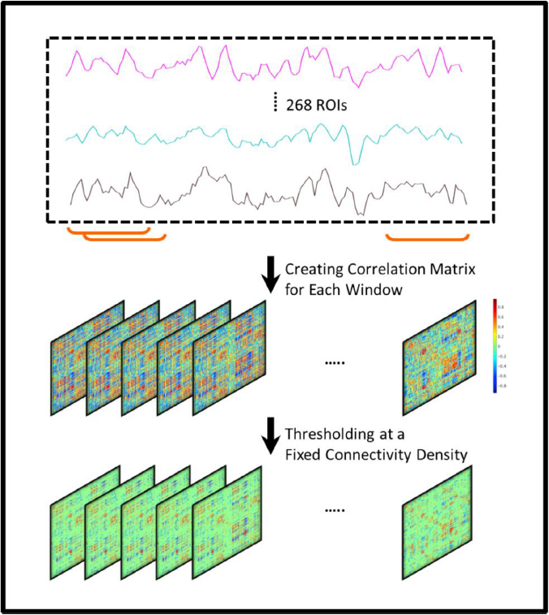

Data
Dynamic correlation
Slide window method
Structure:
Area x Area x Window x Participant
Raw data:
Area
Participant
(For each participant)
Time
$$C_{t}^{i}$$
Area
Window (T-W+1)
Area
Notes:
Remind goal: train model…

Slide 6
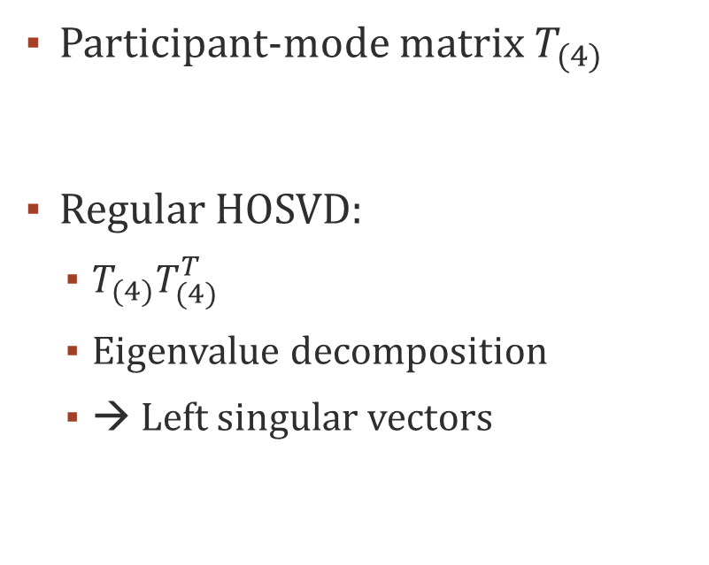



Dimension Reduction
Participant-mode matrix $T_{(4)}$
Regular HOSVD:
$T_{(4)}T_{(4)}^{T}$
Eigenvalue decomposition
→ Left singular vectors
Participant
$$W_{1}$$
$$W_{2}$$
…
Area x Area x Window
$$T_{(4)}T_{(4)}^{T}$$
Participant
Participant
Notes:
Remind goal: train model on activity data & make prediction about individual participant

Slide 7
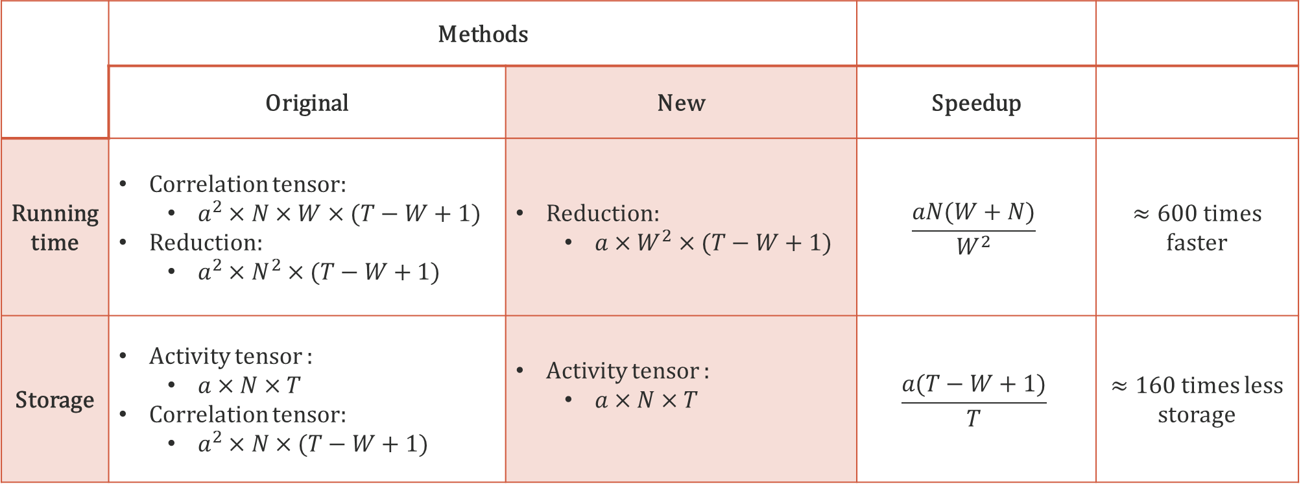
Efficiency
Notations:
a: number of areas (268 ROIs)
T: total number of time points (147)
N: number of participants (66)
W: window size (60)
 | Methods
 | Original | New | Speedup
Running time | Correlation tensor: $a^{2}×N×W×(T−W+1)$ Reduction: $a^{2}×N^{2}×(T−W+1)$ | Reduction: $a×W^{2}×(T−W+1)$ | $$\frac{aN(W+N)}{W^{2}}$$ | $≈600$ times faster
Storage | Activity tensor : $a×N×T$ Correlation tensor: $a^{2}×N×(T−W+1)$ | Activity tensor : $a×N×T$ | $$\frac{a(T−W+1)}{T}$$ | $≈160$ times less storage
Notes:
Original flops combined: $a^{2}N(T−W+1)(W+N)$

Slide 8
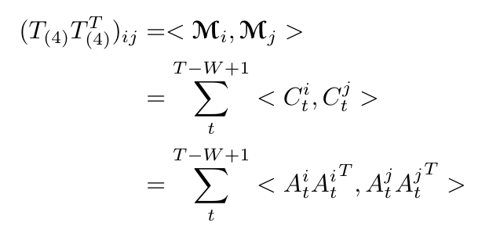








Structure of $T_{(4)}T_{(4)}^{T}$
$$C_{t}$$
Area
Window
Area
$$j^{}$$
$$i^{}$$
$$C_{1}^{i}$$
$$C_{2}^{i}$$
…
$$C_{1}^{j}$$
Area x Area x Window
$$C_{1}^{j}$$
…
Notes:
Remind goal: train model on activity data & make prediction about individual participant

Slide 9



Structure of $T_{(4)}T_{(4)}^{T}$
Area
Participant (N)
W
Time (T)
Area
Area
$$i^{}$$
$$C_{1}^{i}$$
Notes:
Remind goal: train model on activity data & make prediction about individual participant

Slide 10
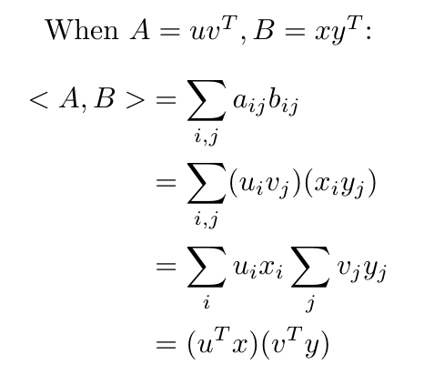
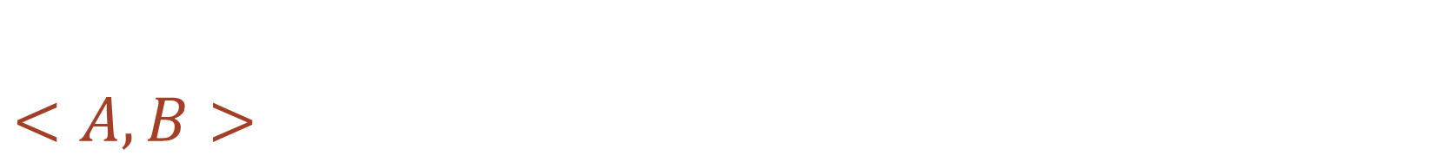
$$<A, B>$$
Notes:
Remind goal: train model on activity data & make prediction about individual participant

Slide 11
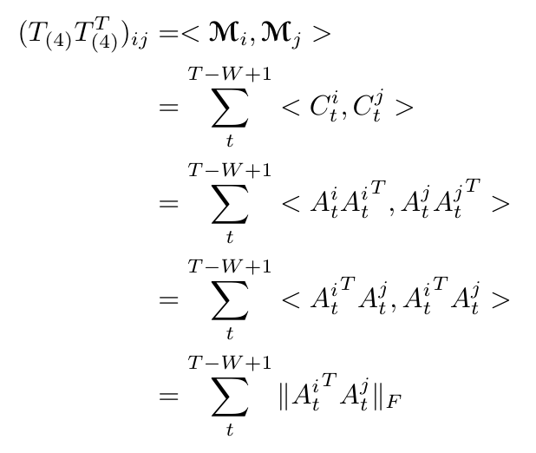




Generalize…
$$t$$
$$j$$
$$i$$
Area
Participant (N)
Time (T)
$$T_{(4)}T_{(4)}^{T}$$
Participant
Participant
Notes:
Remind goal: train model on activity data & make prediction about individual participant

Slide 12
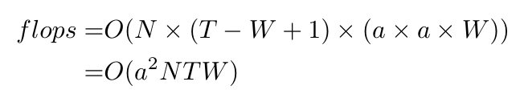
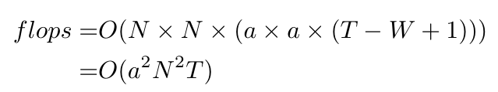




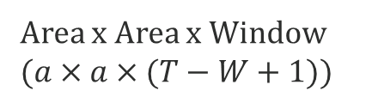
Efficiency: flops
Area
Participant (N)
Original method:
Dynamic correlation matrix:
$T_{(4)}T_{(4)}^{T}$
W
Time (T)
$$C_{t}$$
Area
Window
Area
Participant (N)
$$W_{1}$$
$$W_{2}$$
…
Area x Area x Window ($a×a×(T−W+1)$)
Notes:
Remind goal: train model on activity data & make prediction about individual participant

Slide 13
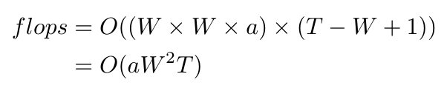
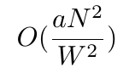

Efficiency: flops
$$A_{p}$$
Area
New method:
Participant (N)
Time (T)
$$T_{(4)}T_{(4)}^{T}$$
Participant
Participant
Notes:
Remind goal: train model on activity data & make prediction about individual participant

Slide 14
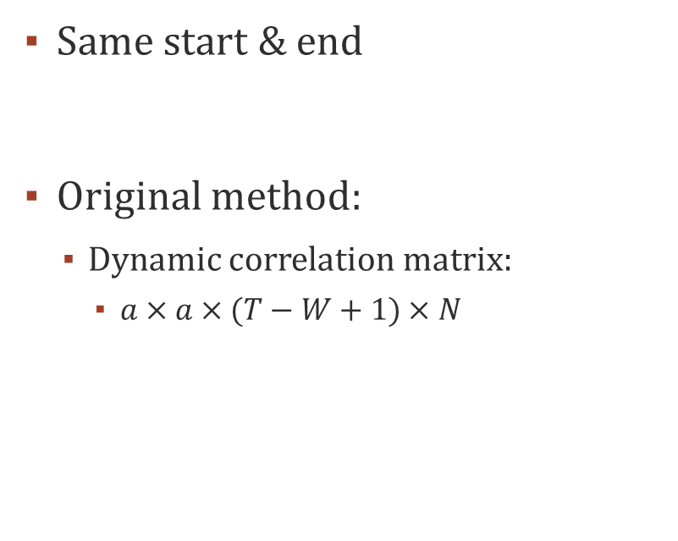



Efficiency: storage
$$T_{(4)}T_{(4)}^{T}$$
$$A_{p}$$
N
Area (a)
Same start & end
Original method:
Dynamic correlation matrix:
$a×a×(T−W+1)×N$
Participant (N)
N
Time (T)
(For each participant)
$$C_{t}$$
Area
Window (T-W+1)
Area
Notes:
Remind goal: train model on activity data & make prediction about individual participant

Slide 15
Questions?

Slide 16
Title and content layout with chart

Slide 17
Two content layout with table
First bullet point here
Second bullet point here
Third bullet point here
Class | Group 1 | Group 2
Class 1 | 82 | 95
Class 2 | 76 | 88
Class 3 | 84 | 90

Slide 18
Title and content layout with SmartArt
Step 1 Title
Task description
Step 2 Title
Task description
Step 3 Title
Task description

Slide 19
Add a Slide Title - 1

Slide 20
Add a Slide Title - 2

Slide 21
Add a Slide Title - 3

Slide 23
Add a Slide Title - 4

Slide 24
Add a Slide Title - 5

